Slide 1
Cephalometric and Skull Imaging

Slide 2
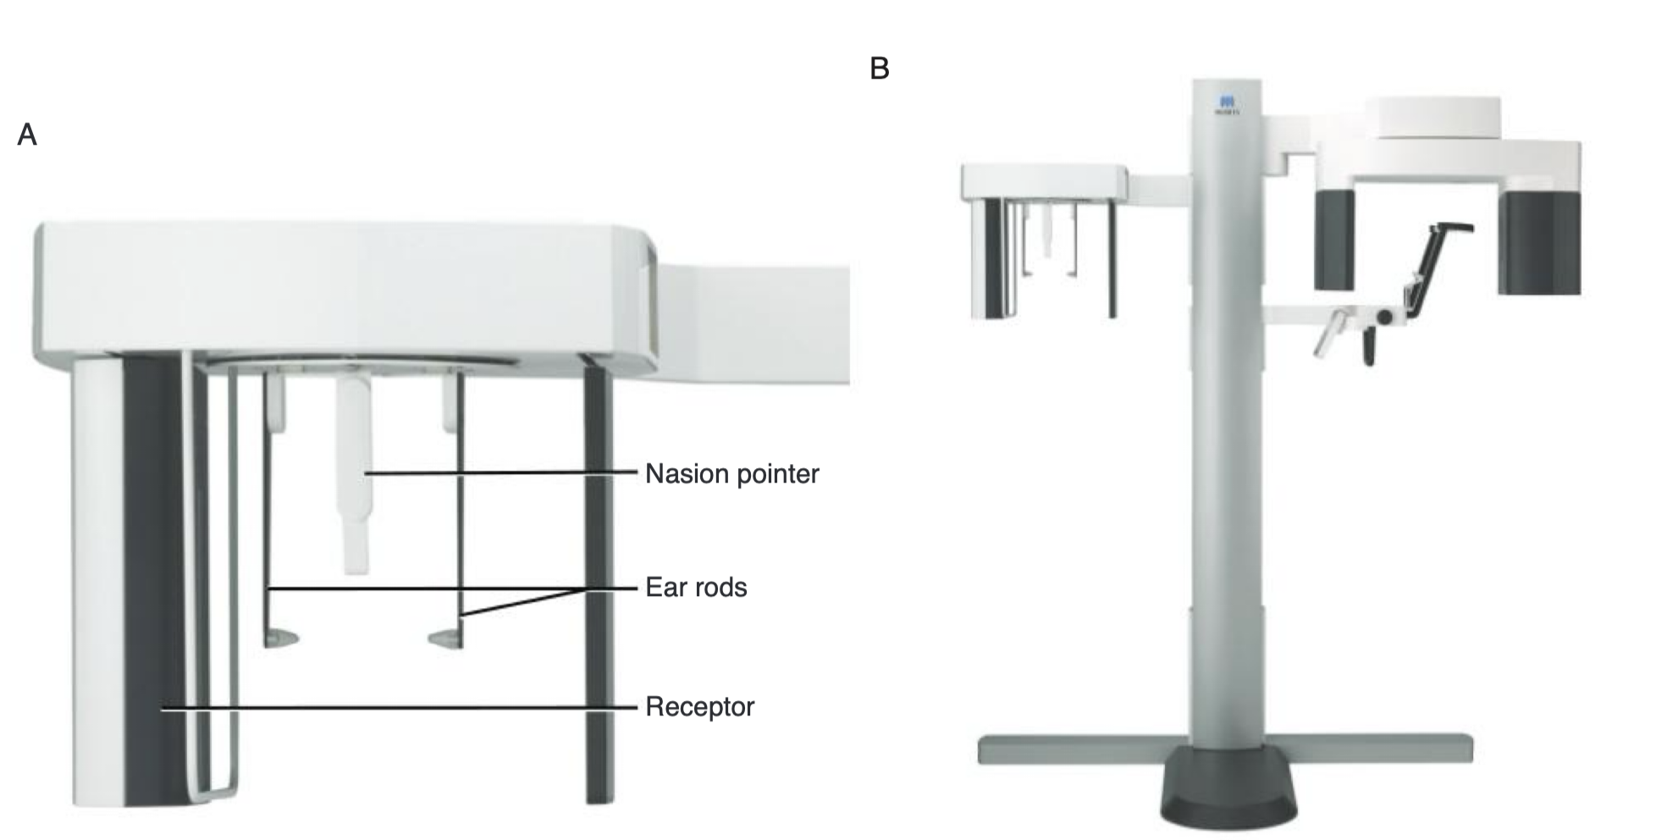

Slide 3
In extraoral radiographic examinations, both the x-ray source and the image receptor (film or digital sensor) are placed outside the patient's mouth
examine areas not fully covered by intraoral
cranium, face (including the maxilla and mandible), or cervical spine for diseases, trauma, or abnormalities.
evaluating the relationship between various orofacial and dental structures, growth and development of the face
treatment progression
The main anatomic landmark used in patient positioning >>> canthomeatal line (central point of the external auditory canal to the outer canthus of the eye)
The canthomeatal line forms approximately a 10-degree angle with the Frankfort (connects the superior border of the external auditory canal with the infraorbital rim)

Slide 4
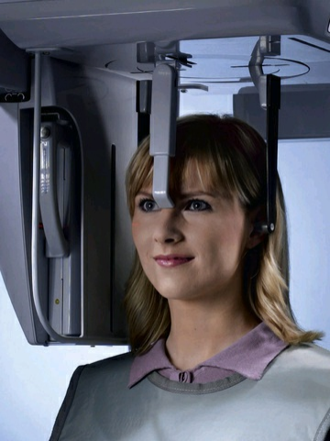
Cephalometric Projections
long source-to-object distance of 5 ft; (minimizes image magnification)
object-to-receptor distance >>> 10 to 15 cm

Slide 5
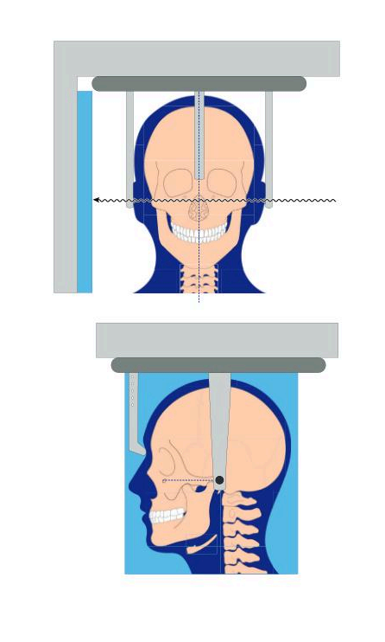
Lateral Cephalometric Projection (Lateral Skull Projection)
Indications
Evaluate the anteroposterior (AP) relationships between the maxilla, mandible, and cranial base
Assess skeletal and soft-tissue relationships
Monitor progress of treatment and treatment outcomes
Proceed with orthognathic surgical treatment planning
The image receptor is positioned parallel to the patient's midsagittal plane.
wedge filter at the tube head >>> absorb some of the radiation and allow visualization of soft tissues
occlude in normal intercuspation position.
central beam perpendicular to the midsagittal plane (centered over the external auditory meatus)

Slide 6
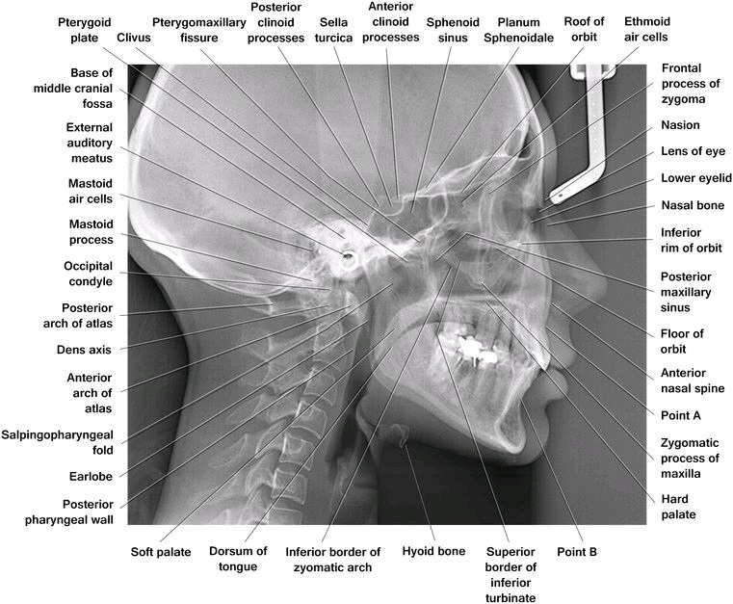
structures near to the receptor >>> magnified less
close to the midsagittal plane demonstrate less discrepancy

Slide 7
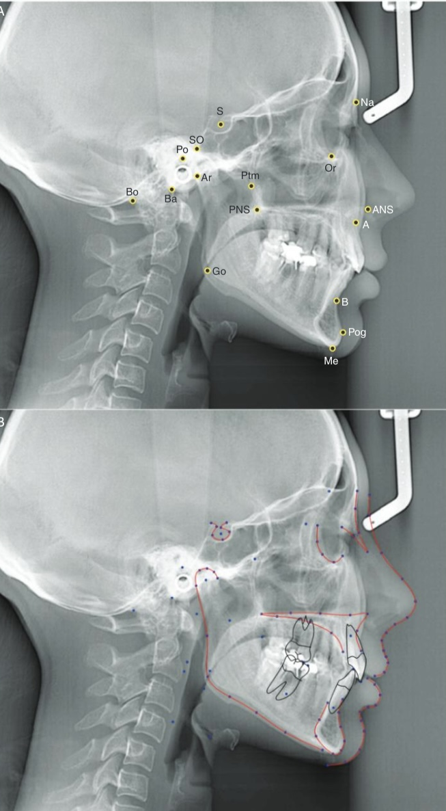
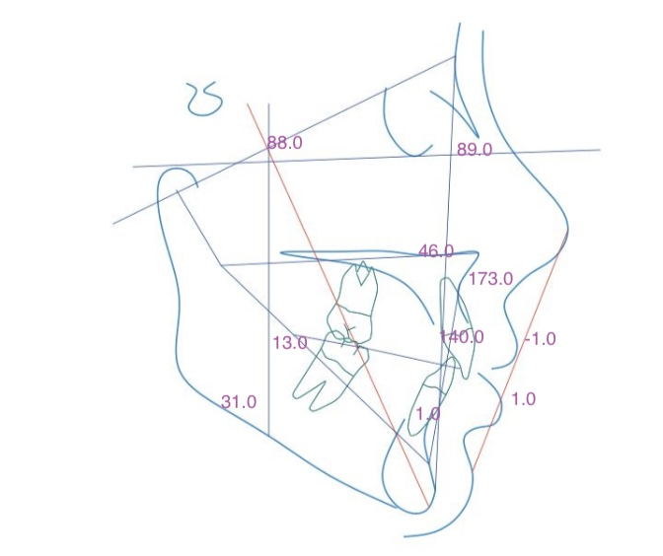

Slide 8
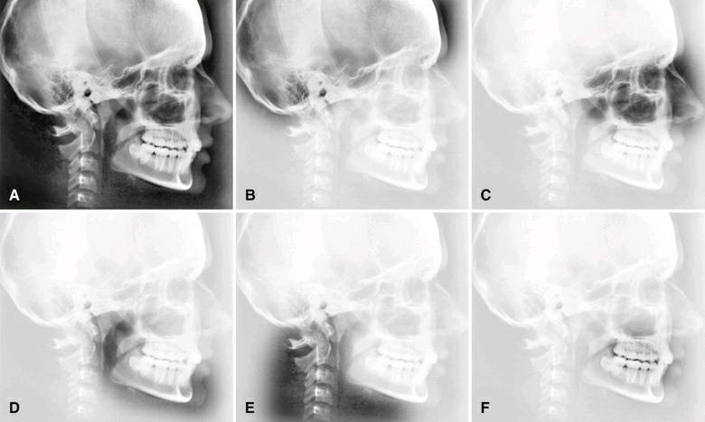
Interpretation
Step 1. Evaluate the base of the skull and calvaria
mastoid air cells,
clivus,
clinoid processes and sella turcica,
sphenoid sinuses,
roof of the orbit
intracranial calcifications
diploic space
Step 2. Evaluate the upper and middle face
orbits,
sinuses (frontal, ethmoid, and maxillary),
pterygomaxillary fissures,
pterygoid plates,
zygomatic processes of the maxilla,
anterior nasal spine,
and hard palate
soft tissues
nasal cavity (turbinates)
Step 4. Evaluate the cervical spine, airway, and area of the neck.
vertebra,
skull-C1 and C1-C2 articulations
soft tissues
hyoid bone
airway
Step 5. Evaluate the alveolar bone and teeth
Step 3. Evaluate the lower face
outline of the mandible
condylar and coronoid processes; to the rami, angles, and bodies, anterior mandible
soft tissue

Slide 9
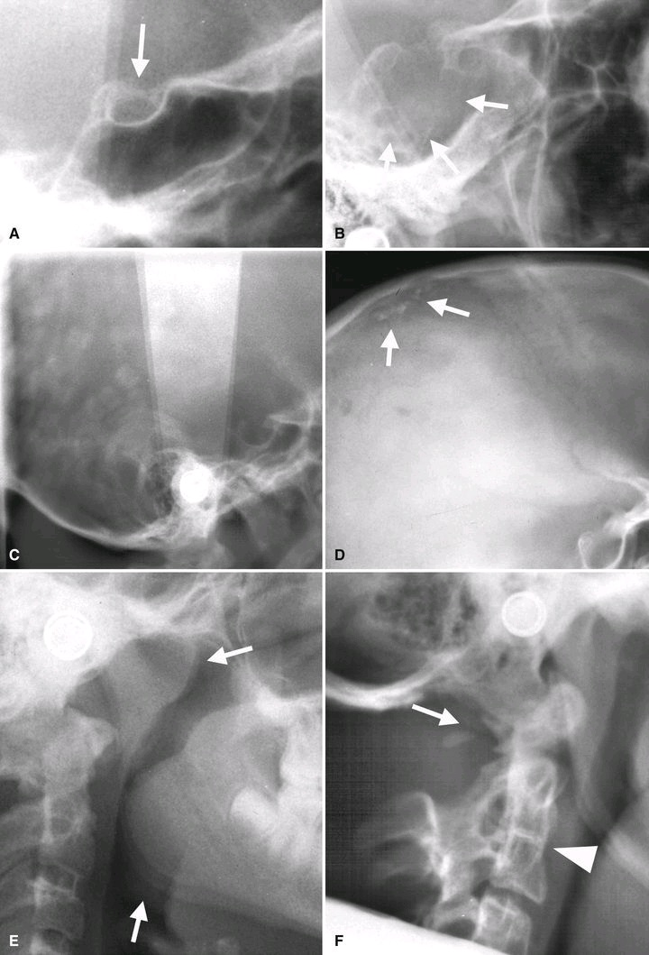
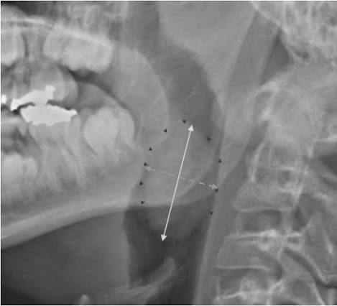
Calcification of the intraclinoid ligament and formation of a bridged
expansion, irregular outlines, and destruction of the sella floor >>> invasive lesion, such as a pituitary tumor
Multiple opacities throughout patient's calvaria are the result of superimposed hair braids
Well defined opacities at the superior aspect of the calvaria represent calcifications of arachnoid granulations
partial agenesis of the ring of atlas (developmental anomaly) >>> instability of the atlanto-occipital and atlanto-odontoid articulation
Enlargement of the pharyngeal adenoids and palatal tonsils >>> narrowing of the airway and breathing difficulties
Fusion of the body and transverse process of the dens
with the third cervical vertebra (normal variant)

Slide 10
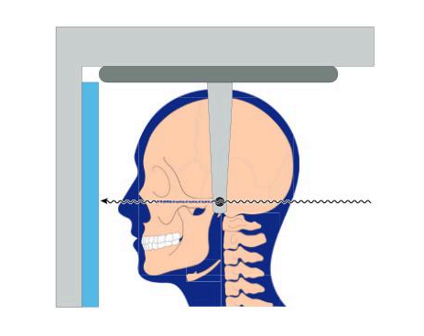
Posteroanterior Cephalometric Projection
Indications
• Evaluate craniofacial asymmetry
• Assess jaw skeletal relationships
• Monitor progress of treatment and treatment outcomes
• Proceed with orthognathic surgical treatment planning
image receptor >>> in front of the patient, perpendicular to the midsagittal plane and parallel to the coronal
PA cephalometric : canthomeatal line forms a 10-degree angle with the horizontal plane (Frankfurt plane and is perpendicular )
PA skull : canthomeatal line is perpendicular
central beam from posterior to anterior
bridge of the nose

Slide 11
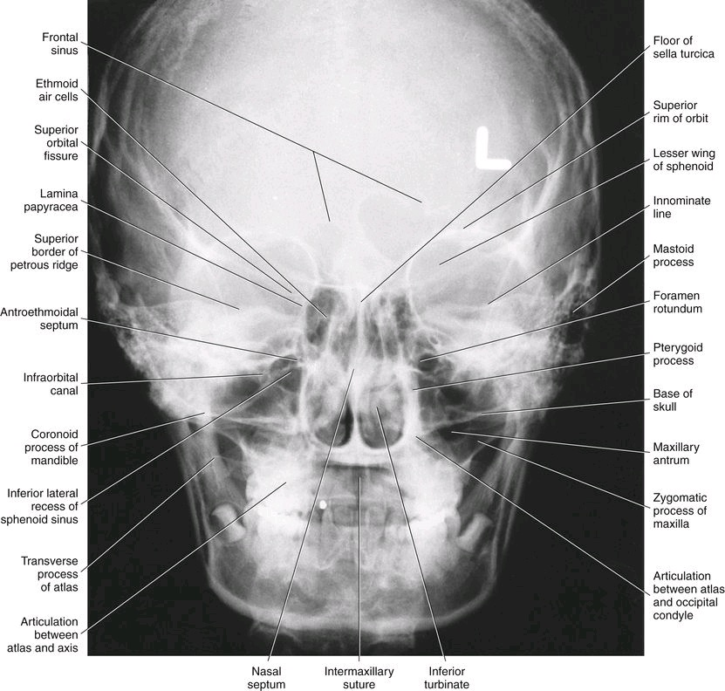
Resultant Image
The superior border of the petrous ridge should lie in the lower third of the orbit.

Slide 12
Craniofacial and Skull Projections

Slide 13
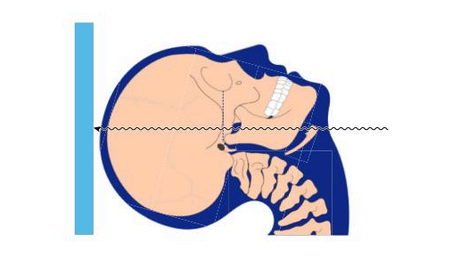
Submentovertex (Base) Projection
Indications
base of the skull (osseous changes from skull base tumors)
the zygomatic arches (fractures of the zygomatic arches)
sphenoid sinuses (integrity and aeration of the sphenoid sinuses)
The image receptor >>> parallel to transverse plane
canthomeatal line parallel to the image receptor
central beam is perpendicular to the image receptor(centered about 2 cm anterior to a line connecting the right and left condyles)
buccal and lingual cortical plates of the mandible

Slide 14
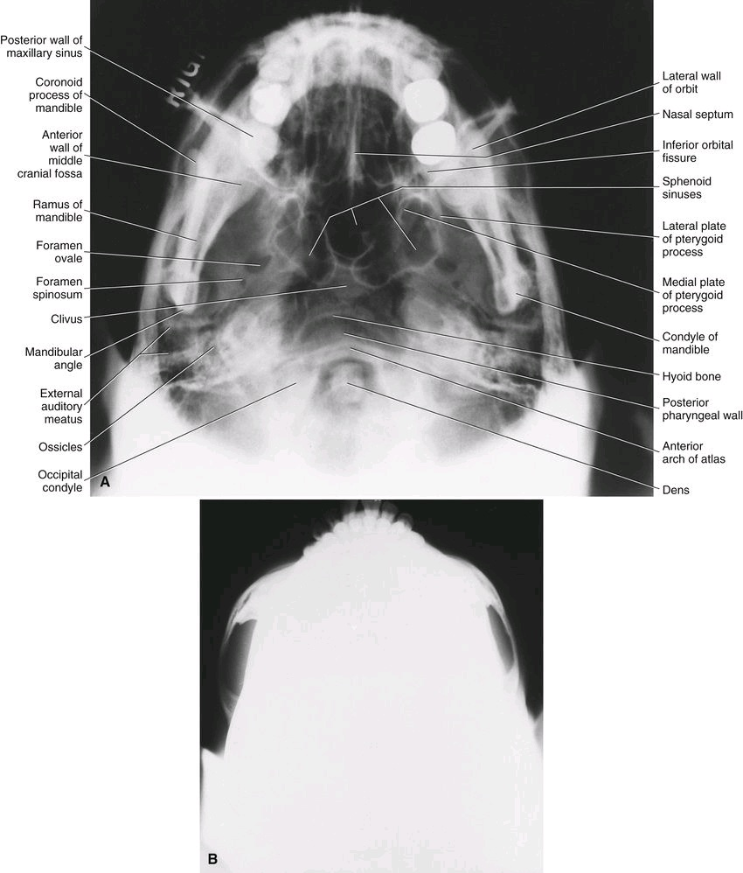
underexposed >>> zygomatic arches (burned out on normal exposure)

Slide 15
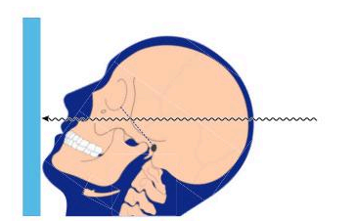
Waters Projection (occipitomental)
Indications
paranasal sinuses (predominantly the maxillary sinus and to a lesser extent the frontal sinus and ethmoid air cells)
midfacial bones and orbits
head is tilted upward so that the canthomeatal line forms a 37-degree angle with receptor
Open mouth >>> sphenoid sinus is seen superimposed over the palate
central beam >>> maxillary sinuses
The petrous ridge of the temporal bone should be projected below the floor of the maxillary sinus

Slide 16
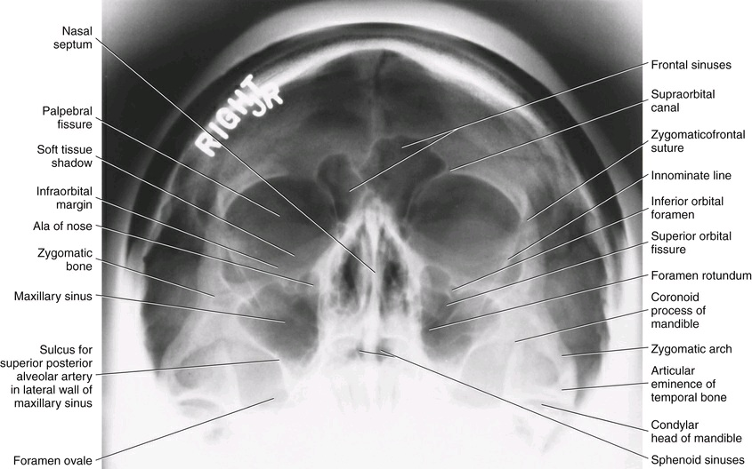

Slide 17
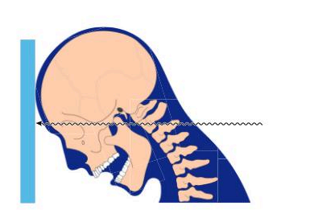
Reverse Towne Projection (Open Mouth)
Indications
patients with suspected fractures of the condyle and condylar neck
patient's head is tilted downward (the canthomeatal line forms a 30-degree angle with the image receptor)
To improve the visualization of the condyles, the patient's mouth is opened so that the condylar
heads are located inferior to the articular eminence.
evaluate condyles >>> necessary to specify “open-mouth reverse Towne”
central beam >>> centered at the level of the condyles
The petrous ridge >>> superimposed at the inferior part of the occipital bone, and the condylar heads should be projected inferior to the articular eminence.

Slide 18
